Slide 1



Sponsorship opportunities
We bring together engineering and consulting leaders—a community driven by ambition and a passion for growth.
Our members are not mere spectators; they actively seek to forge connections, expand their knowledge, and collaborate with industry peers to uncover solutions that pave the way forward.

Slide 2
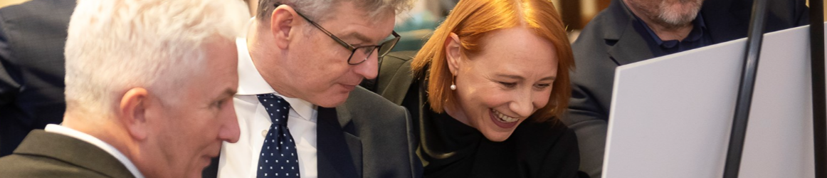
Sponsorship opportunities
We’re inviting potential sponsoring partners to collaborate on impactful initiatives. Current opportunities include the ACE and EIC Parliamentary receptions, our annual awards programme, industry reports and thought leadership activity.
These opportunities allow your organisation to showcase your expertise, commitment, and support for UK infrastructure while gaining visibility among key stakeholders.

Slide 3
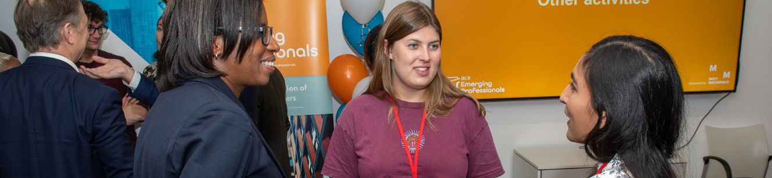
Sponsorship opportunities
We bring together engineering and consulting leaders—a community driven by ambition and a passion for growth.
Our members are not mere spectators; they actively seek to forge connections, expand their knowledge, and collaborate with industry peers to uncover solutions that pave the way forward.

Slide 4
Why sponsor?
Economic Impact
Infrastructure plays a pivotal role in our nation’s economic growth and prosperity. The UK
consulting and engineering sector alone contributes to over 420,000 jobs across 70,000 companies, with a market size exceeding £62 billion.
Exclusive Access
By partnering with ACE and EIC, you gain unique access to influential decision-makers, including business owners and C-suite executives. Our members employ over 60,000 in UK and 250,000 worldwide, contributing more than £15 billion to the UK economy.
Brand Association
Sponsorship aligns your organisation with ACE. We’re widely recognised by the government, industry, and media as the authoritative voice in engineering and consultancy. Your brand will be prominently featured alongside some of the industry’s biggest names.

Slide 5
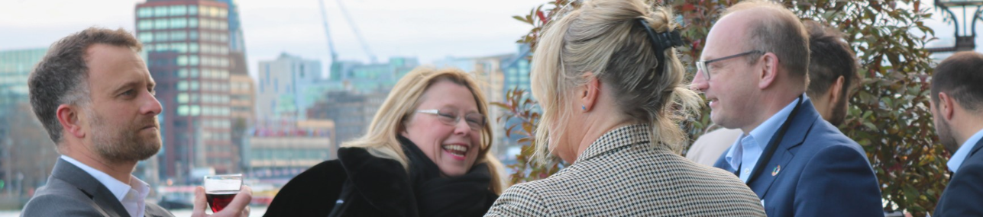
Why sponsor?
Networking Opportunities
Engage directly with public and private sector decision-makers through tailored networking forums. Forge meaningful connections and communicate your message effectively.

Slide 6
Excellence meets opportunity
High-Level Technical Content: Our sessions feature cutting-edge insights, technical expertise, and forward-thinking solutions. From thought-provoking keynotes to interactive workshops, we deliver content that resonates with senior decision-makers, young professionals, and change-makers alike.
Thought Leadership: Engage with industry luminaries who share their vision, expertise, and strategic perspectives. Our events serve as a platform for thought leaders to shape the future of our sector.
Business Critical Solutions: Attendees gain access to practical solutions that address real-world challenges. Whether it’s innovative project management techniques or sustainable infrastructure practices, our events empower professionals to drive positive change.

Slide 7
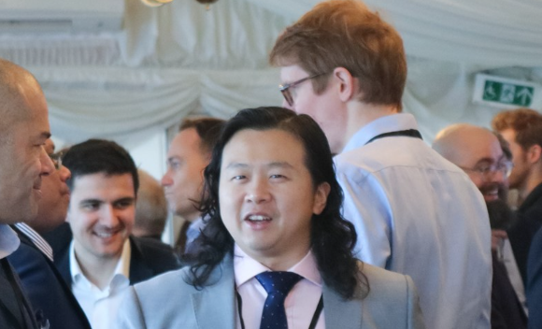
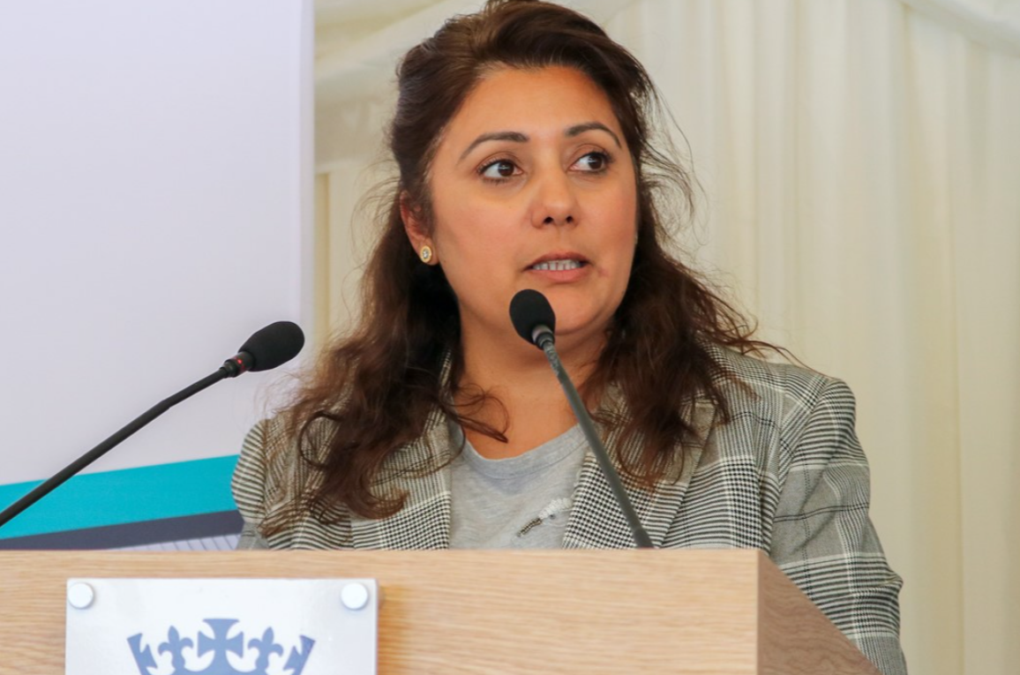
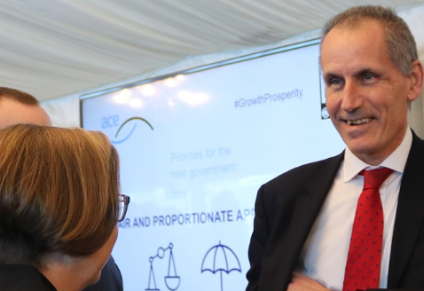
EIC Parliamentary Reception & ACE Parliamentary Reception
These exclusive events, with a limited guest capacity of 200, offer a distinctive networking experience.
Connect with peers, clients, Members of Parliament (MPs), and policymakers. But it’s more than just networking—it’s a chance to showcase our industry’s brilliance in addressing socio-economic and environmental challenges.

Slide 8
EIC Parliamentary Reception 13 June 2024
Headline sponsorship: £11,000
ACE Parliamentary Reception 28 November 2024
Headline sponsorship: £11,000
 | EIC Reception | ACE Reception
Headline sponsor acknowledgement and logo on event marketing materials (pre and post event) | P | P
Headline sponsor acknowledgement and logo on PowerPoint slides during the event | P | P
Your marketing material with 2 x promotional banners at the event *Dimensions to be agreed with ACE | P | P
Access to hi-res images for your own marketing | P | P
Your logo on the event listing on the ACE website (ACE Parliamentary Reception) or EIC website (EIC Reception) | P | P
250-word profile on the ACE website with logo and link to your company website | P | P
5 Guest places at the sponsored reception | P | P

Slide 9
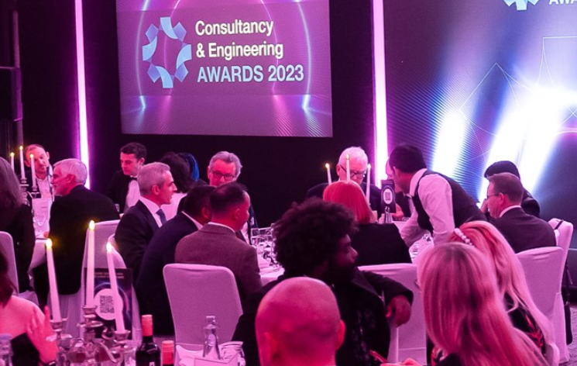
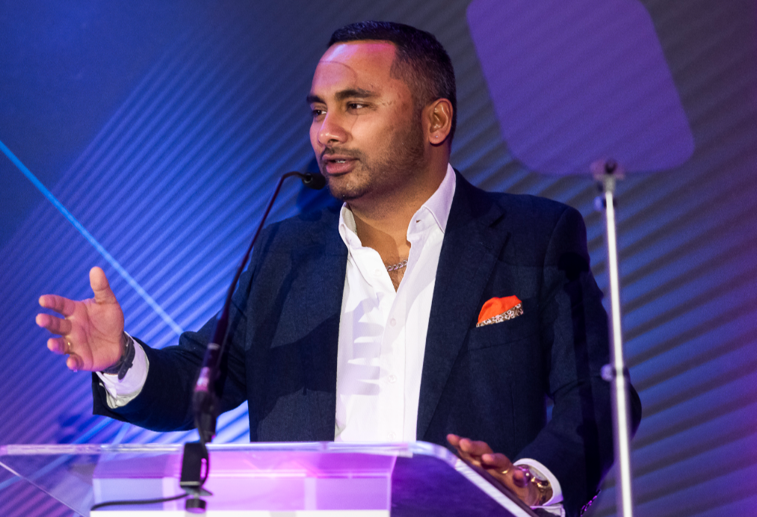
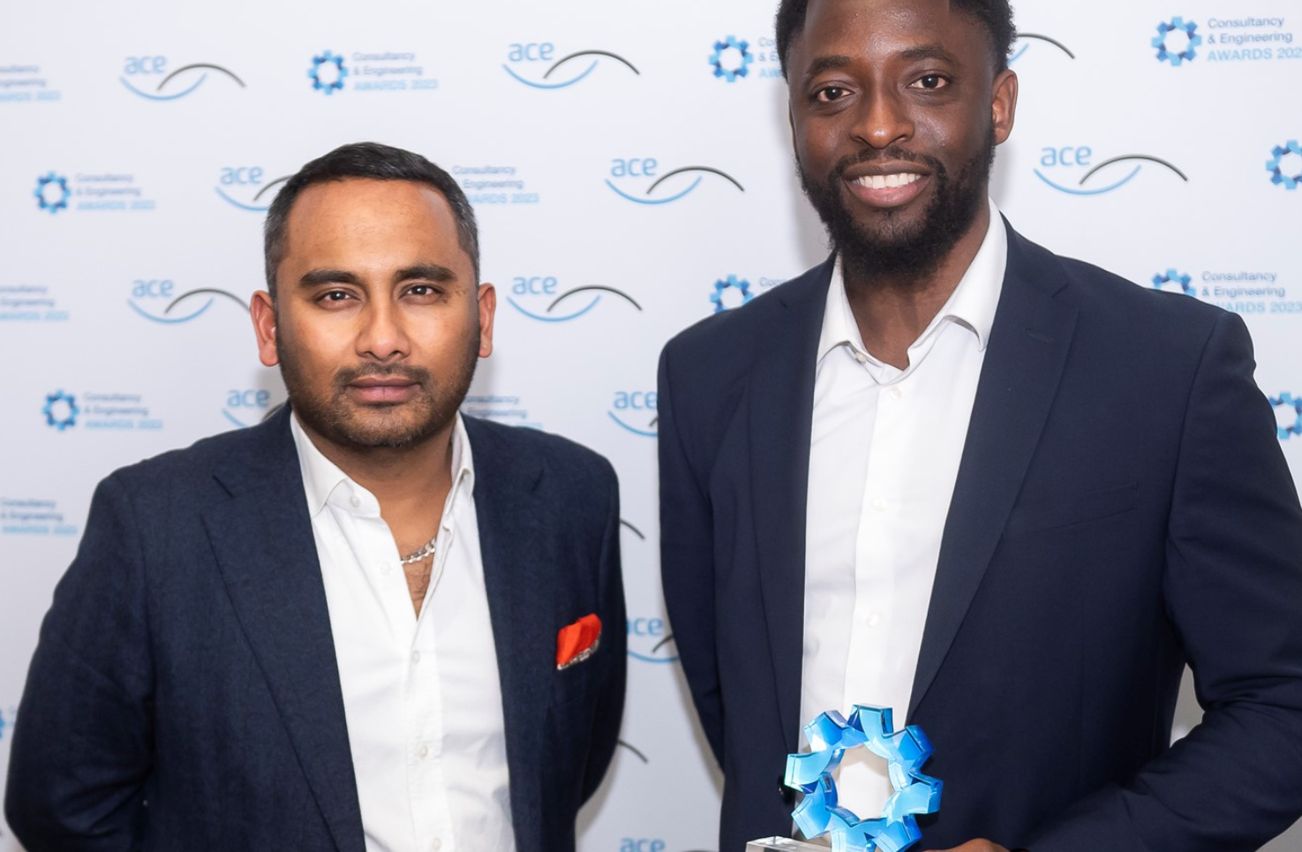
Engineering and Consultancy Awards
These prestigious awards celebrate the outstanding achievements of our industry and champions the best people, projects and companies from the world of engineering, consultancy and the built environment.
The Consultancy & Engineering Awards provide a great way to demonstrate industry leadership, and are they’re an excellent opportunity to celebrate performance, recognise and reward colleagues, and shine the spotlight on partners and clients.

Slide 10
Engineering and Consultancy Awards
2024 categories:
Best UK Consultancy
Micro
Small
Medium
Large
Best Transport Project
Best Innovation and Technology
Lifetime Achievement
Best Sustainability Project
Best Social Value
Client of the Year
Inclusive Employer of the Year
Apprentice of the year
Emerging professionals

Slide 11
Engineering and Consultancy Awards
Headline sponsor: £10,000
Category sponsors: £ 3,000
 | Headline sponsor | Category sponsor | Media partner | Supporter
Headline sponsor acknowledgement and logo on event marketing materials (pre and post event) | P
Headline sponsor acknowledgement and logo on PowerPoint slides during the event | P
Category sponsor acknowledgement and logo on event marketing materials (pre and post event) |  | P
Category sponsor acknowledgement and logo on PowerPoint slides during the event |  | P
Media partner acknowledgement and logo on event marketing materials (pre and post event) |  |  | P
Media partner acknowledgement and logo on PowerPoint slides during the event |  |  | P
Supporter sponsor acknowledgement and logo on event marketing materials (pre and post event) |  |  |  | P
Supporter acknowledgement and logo on PowerPoint slides during the event |  |  |  | P
Guest places at the event | 10 | 2 | 1 | 1
Judging places | 2+ | 1 | 1 | 1
Your marketing promotional banners at the event *Dimensions to be agreed with ACE. | 2 | 1 | 1 | 1
Access to hi-res images for your own marketing | P | P | P | P
Your logo on the event listing on the ACE website | P | P | P | P
250-word profile on the ACE website with logo and link to your company website | P | P | P | P
Advert in Awards on the night brochure | P | P | P | P

Slide 12

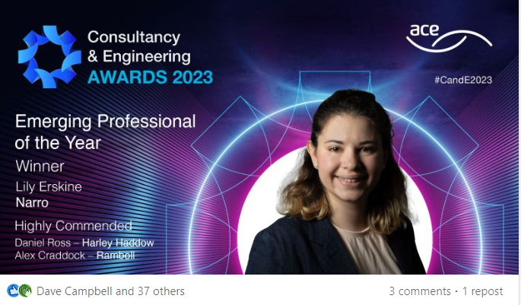
Engineering and Consultancy Awards
“We're honoured to win this award which is testament to our commitment to integrate inclusion into every aspect of our industry. We're delighted that our progress has received prominent recognition this year and remain focussed on creating a supportive and inclusive environment for all our colleagues”
Richard Risdon, Managing Director for UK and Europe, Mott MacDonald
“The market has been challenging for the last few years, but we have looked after each other and worked hard – so to see that recognised is incredibly satisfying, it’s a real boost for the team. These awards allow us the opportunity to take stock – and celebrate.”
Philippa Spence, UK Managing Director, Ramboll

Slide 13

Industry insight & guidance
Prominent logo placement on the cover page of the report/action plan.
Exclusive sponsor viewpoint.
Priority speaking slot at the online webinar, which will be an opportunity to discuss the report and wider thought leadership.
200-word profile on the ACE/EIC website, logo and link to your website.

Slide 14

Industry insight & guidance
Social media promotion mentioning your sponsorship
Forthcoming topics: Future Skills, The Future of The Workplace, Emerging and Disruptive Technology, Financing Climate Innovation, Developing Resilient Places Attractive to Commercial and Social Interests, Future Trends in Transport Infrastructure
Sponsorship packages vary please contact us for more information.

Slide 15
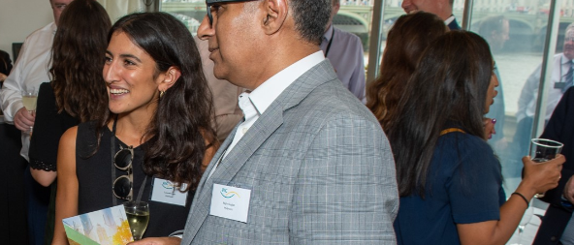
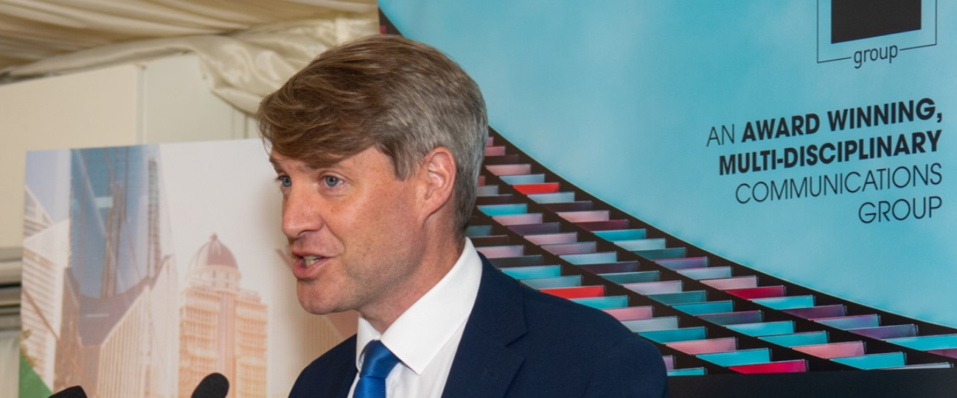
If your organisation would like to sponsor or partner with us, please contact Natasha Boyle: nboyle@acenet.co.uk or Dave Campbell: dcampbell@acenet.co.uk

